Slide 1


Gas Station Sim
DATA 604 Final Project
Alec McCabe

Slide 2
Project Overview
In order for gas stations to optimize the number of customers that enter their lot and fill up their cars with gas, they must understand the local demand and weight that against their infrastructure costs.
Determining the optimal number of fill-up stations is critical.
Building too many will incur unnecessary costs on the owner.
Building too few will lead to growing queues and angry customers.
This project is focused on constructing a simulation to determine the effect of building different numbers of fill-up stations at a gas station.

Slide 3
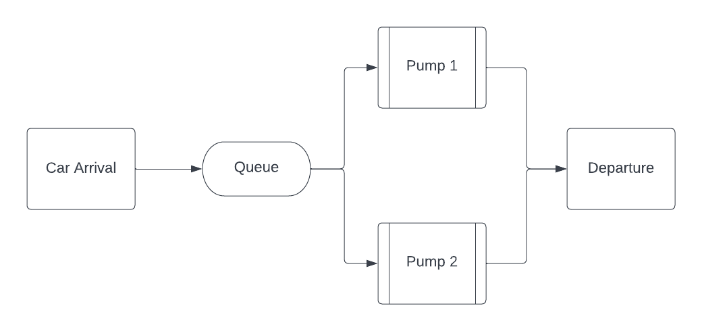
Flowchart
Simple Model:
Customers arrive at the fill-up station following an exponential distribution with mean = 2 minutes
Customers wait in queue until a fill-up station is available
Customers fill-up their cars following a normal distribution with mean = 4 min and standard deviation = 0.7 minutes

Slide 4
The Process
Simple Model:
Customers arrive at the fill-up station following an exponential distribution with mean = 2 minutes
Customers wait in queue until a fill-up station is available
Customers fill-up their cars following a normal distribution with mean = 4 min and standard deviation = 0.7 minutes
Simulation:
Run for 100 iterations
Store information on queue size, individual wait times for cars, and fill-up station utilization
Want to find the number of pumps that minimized queue length, stops from becoming unbounded.

Slide 5
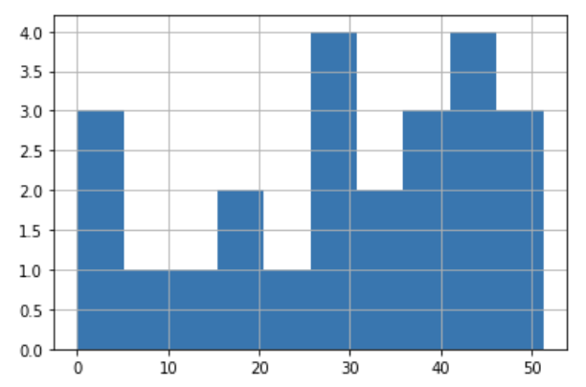
Simulation Results – 1 Pump
Wait Time Distribution
1 arrives at 1.34
1 enters the queue at 1.34
1 leaves the queue at 1.34
2 arrives at 1.47
2 enters the queue at 1.47
3 arrives at 3.29
3 enters the queue at 3.29
4 arrives at 4.42
4 enters the queue at 4.42
5 arrives at 4.81
5 enters the queue at 4.81
6 arrives at 5.48
6 enters the queue at 5.48
1 time_taken 4.22
2 leaves the queue at 5.57
7 arrives at 5.63
7 enters the queue at 5.63 …
Average Delay in Queue: 29.08
Average Delay in System: 33.02
Average Cars in Queue: 13.92
Average Utilization: 98%

Slide 6
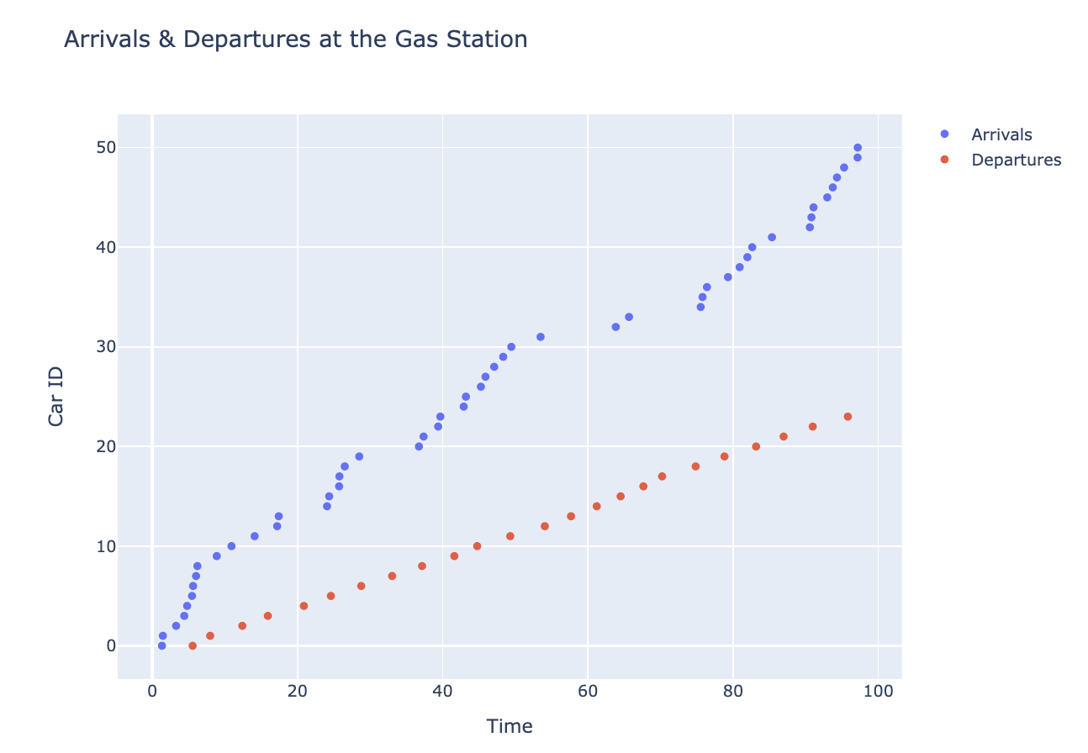
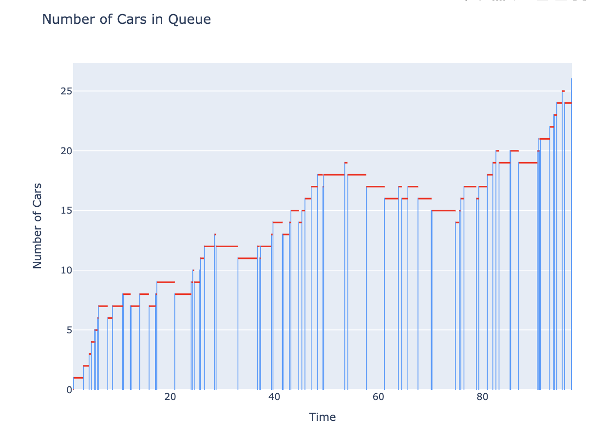
Simulation Results – 1 Pump
Because there is only 1 pump, and the rate of new cars is faster than the rate of fill-up, we see a bottleneck at the station
This leads to a situation of unbounded queue growth.

Slide 7
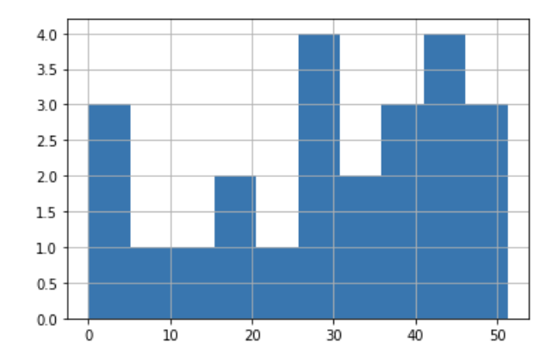
Simulation Results – 2 Pumps
Wait Time Distribution
1 arrives at 1.34
1 enters the queue at 1.34
1 leaves the queue at 1.34
2 arrives at 1.47
2 enters the queue at 1.47
2 leaves the queue at 1.47
3 arrives at 3.29
3 enters the queue at 3.29
2 time_taken 2.41
3 leaves the queue at 3.88
4 arrives at 4.42
4 enters the queue at 4.42
5 arrives at 4.56
5 enters the queue at 4.56
6 arrives at 4.97
6 enters the queue at 4.97
7 arrives at 5.16
7 enters the queue at 5.16
Average Delay in Queue: 2.43
Average Delay in System: 6.30
Average Cars in Queue: 1.09
Average Utilization: 59%

Slide 8
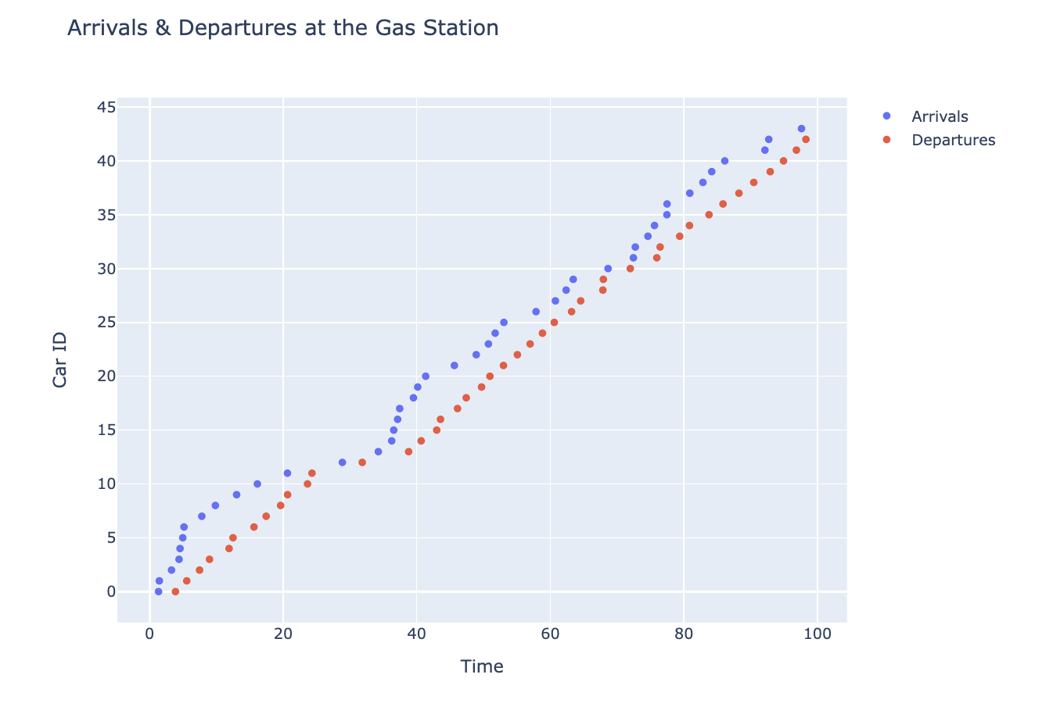
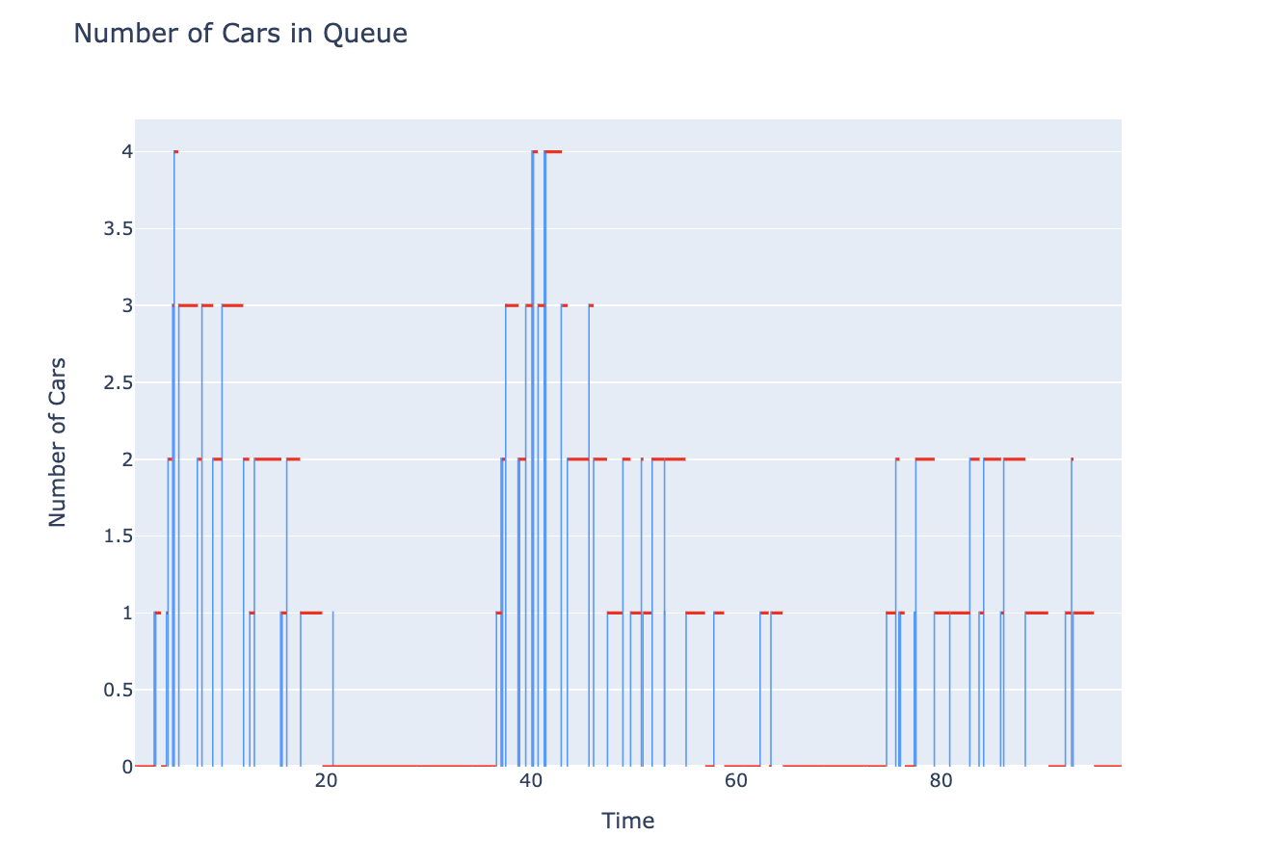
Simulation Results – 2 Pumps
With 2 pumps, the wait time does not grow unbounded. We see that all cars share a similar wait time regardless of when they enter the system
The total number of cars in the queue at any given time does not exceed 5

Slide 9
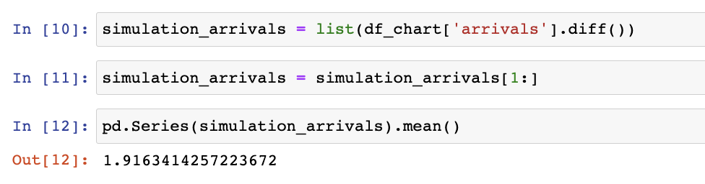
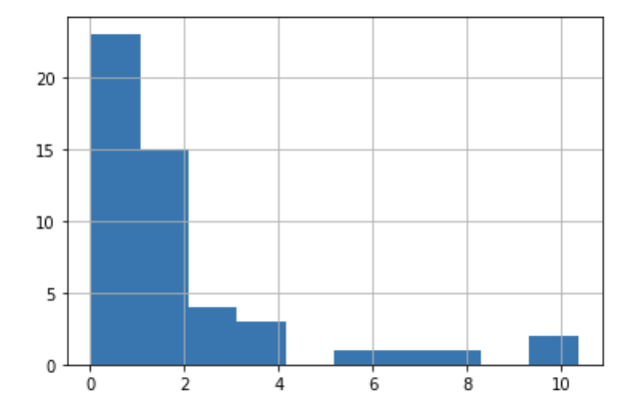
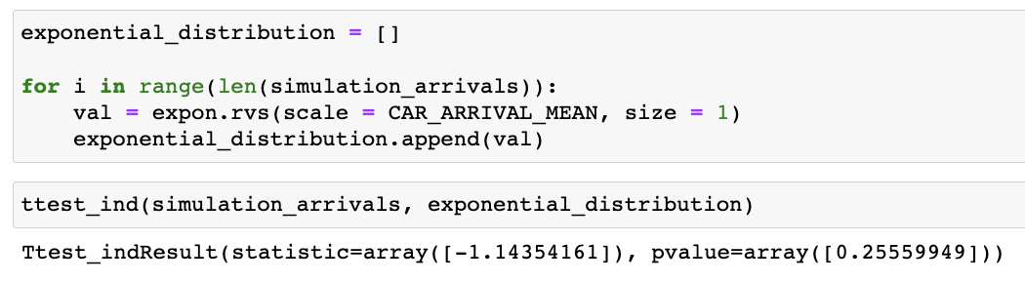
Justify Validity of Model - Arrivals
This model used an exponential distribution to model incoming customers and a normal distribution to model the time to fill-up a car with gas
Simulation Mean approximates input distribution mean
Two Sample T-Test Fails to Reject null hypothesis that populations are distinct
Simulation Distribution is exponential

Slide 10
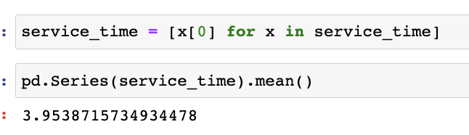
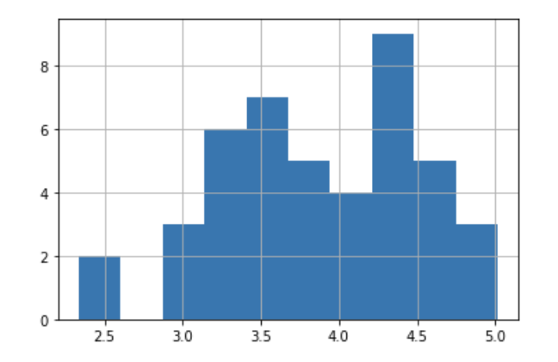
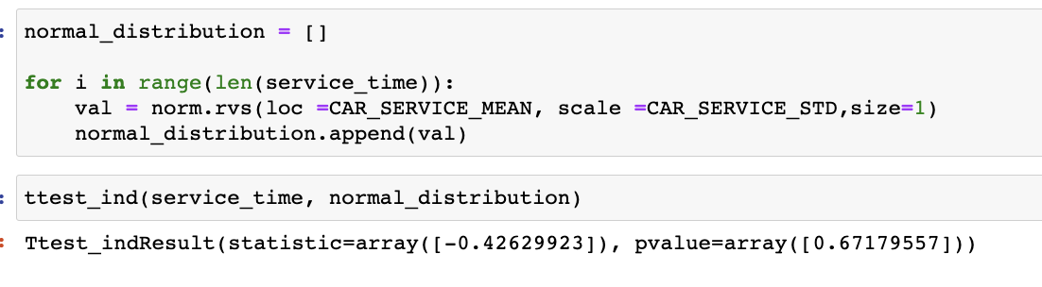
Justify Validity of Model – Fill-ups
This model used an exponential distribution to model incoming customers and a normal distribution to model the time to fill-up a car with gas
Simulation Mean approximates input distribution mean
Two Sample T-Test Fails to Reject null hypothesis that populations are distinct
Simulation Distribution is roughly normal

Slide 11
Conclusions
Using Simpy, we were able to create a simple Discrete Event Simulation of a city gas station.
Given that:
- cars will enter the system with a exponential distribution (mean of 2 minutes)
- cars will fill up their tanks with a normal distribution (mean of 4 minutes, std of .7 minutes)
We see that the using only one pump results in an unbounded increase in the size of the queue. As time progresses, the queue size will increase indefinitely. This is due to the fact that cars are serviced FIFO, and that the time it takes for service a car is greater the time between new cars entering the queue.
When we use two pumps, we see that the total size of the queue at a given time is capped below 5. Also important to notice is that when using 2 pumps, there are moments when the queue size shrinks to 0.

